Slide 1
Exam-2: Review
CS 1714 – Computer Programming II

Slide 2
Pattern printing 1
Given an integer N, write code to print the following pattern. N can be any value. Your code should adapt to the given value and print correspondingly. HINT: find the common pattern.
N=1
*
N=2
*
* | *
N=3
*
* | *
* | * | *
N=4
*
* | *
* | * | *
* | * | * | *
N=5
*
* | *
* | * | *
* | * | * | *
* | * | * | * | *
Empty cells in the table refer to white spaces. While printing, white spaces in the front matter, whereas ones at the end do not matter and need not be printed.

Slide 3
Pattern printing 1
Given an integer N, write code to print the following pattern. N can be any value. Your code should adapt to the given value and print correspondingly. HINT: find the common pattern.
int i = 0, j = 0, N = 5;
for(i=0; i<N; i++)
{
for(j=0; j<=i; j++)
{
printf("*");
}
printf("\n");
}

Slide 4
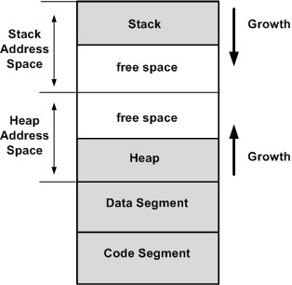
Memory
When you execute a C program, the operating system will allocate memory for your program.
This diagram shows the memory layout of a typical C program.
Memory addresses grow upward. The lowest memory address is at the bottom of the code segment and the highest address is at the top of the stack.
Image source: https://open4tech.com/concept-heap-usage-embedded-systems/

Slide 5
Pointer Arithmetic (Theoretical / Paper) Example – 1
Trace the following code. Show the starting address, the intermediate and final values of the variables at each step. char values are 1 byte, int are 4 bytes, double are 8 bytes, any type of pointer variables are 8 bytes. Assume that the starting address is 1000.
Variable Name | Starting Address | Value
X | 1000 | 20
Y | 1004 | 30
Z | 1008 | 40
p | 1012 | 1020 1024 1028 1032
arr[0] | 1020 | 6 10
arr[1] | 1024 | 5
arr[2] | 1028 | 4
arr[3] | 1032 | 3 20
arr[4] | 1036 | 2
int X = 20, Y = 30, Z = 40;
int* p;
int arr[5] = { 6, 5, 4, 3, 2 };
p = arr;
*p++ = 10;
p = &arr[2];
*++p = 20;

Slide 6
Pass-by-Value
By default, parameters are passed by value (like in Java).
A copy of the actual parameter’s value is passed to the function.
int main(int argc, char* argv[])
{
int foobar = 0;
doSomething(foobar);
/* actual parameter foobar does not
change from this function call.
This prints 0 */
printf(“%d”, foobar);
}
void doSomething(int x)
{
x = 1000;
}

Slide 7
Pass-by-Pointer
To call this function, we need to pass the memory address of the actual parameter using the reference & operator.
The memory address of foobar is passed to the function.
int main(int argc, char* argv[])
{
int foobar = 0;
doSomething(&foobar);
/* actual parameter foobar is
changed after this function call. This prints 1000 */
printf(“%d”, foobar);
return 0;
}
void doSomething(int* x)
{
*x = 1000;
}
Change the contents of what x is pointing at to 1000.
This is how scanf() works.

Slide 8
Example – Pass by Value/Pointer
#include <stdio.h>
double computeSq(double);
void posVal(double*);
int main(int argc, char* argv[])
{
double x;
printf("Enter value : ");
scanf("%lf”, &x);
printf("Square of %lf is %lf\n", x, computeSq(x));
return 0;
}
double computeSq(double x)
{
double sq = 0;
posVal(&x);
sq = x*x;
return sq;
}
void posVal(double* x)
{
if(*x < 0)
*x = 0;
}

Slide 9
#include Pathways
main.c uses functions that are declared in foobar.h, so main.c must #include"foobar.h". The functions in foobar.c are declared in foobar.h so foobar.c also includes #include"foobar.h"
/* File: main.c */
#include<stdio.h>
#include"foobar.h"
int main(int argc, char* argv[])
{
int c;
scanf("%d", &c);
printValue(c + MAX);
return 0;
}
/* File: foobar.h */
#ifndef FOOBAR_H
#define FOOBAR_H
#define MAX 10
void printValue(int);
#endif
/* File: foobar.c */
#include<stdio.h>
#include"foobar.h"
void printValue(int x)
{
printf("%d\n", x);
}

Slide 10
Compiling with Separate Files
Include each source file in the gcc command. You never include header files.
You can add the options (e.g., -lm, -o) after.
gcc main.c foobar.c

Slide 11

Two Approaches for Declaring a struct
You can declare a struct with OR without a typedef.
/* Original Approach without the typedef */
struct Product
{
char name[100];
double price;
int quantity;
};
// Usage
struct Product myProduct;
/* Approach with typedef */
typedef struct Product
{
char name[100];
double price;
int quantity;
} Product;
// Usage
Product myProduct;
We will use the typedef approach.

Slide 12
Using a struct
To access each data member in the struct, we need the name of the struct variable, a period, and the desired data member (the variable's identifier). Here are examples of accessing the data members.
Product myProduct;
myProduct.price = 1.25;
myProduct.quantity = 100;
strcpy(myProduct.name, "Apples");
printf("%s: %d\t %.2lf\n", myProduct.name, myProduct.quantity, myProduct.price);
You need to initialize all the data members.

Slide 13
Dynamic Allocation of a Single struct object
The major difference now is how we access the data member of a single, dynamically allocated struct object. We need the name of the struct variable, the arrow operator ->, and the desired data member. As always, initialize all data members before use.
Product* p;
p = (Product*)malloc(sizeof(Product));
p->price = 1.25;
p->quantity = 10;
strcpy(p->name, "Apples");
printf( "%s: %d\t %.2lf\n", p->name, p->quantity, p->price);

Slide 14
Dynamic Allocation of an Array of struct’s
Dynamic allocation of an array of struct objects follows the same syntax as a dynamic allocation of an array of primitive data types.
In this example, we will dynamically allocate an array of 10 Product struct objects. We just have to multiply the sizeof() expression by the number of items we want.
Product* p;
p = (Product*)malloc(10 * sizeof(Product));

Slide 15
Dynamic Allocation of an Array of struct’s
Accessing the data members of a struct object within a dynamically allocated array of struct objects follows the same syntax as a regular struct array. We need the subscript operator for the struct array and use the dot notation to access the data member.
Product* p;
p = (Product*)malloc(10 * sizeof(Product));
p[0].price = 1.25;
p[0].quantity = 100;
strcpy(p[0].name, "Apple");
p[1].price = .79;
p[1].quantity = 200;
strcpy(p[1].name, "Banana");

Slide 16
FILE
r - reads a file
w - creates a new file, delete the contents if the file exists
a – appends to the end of the file
r+ - reading and writing
w+ - reading and writing, delete the contents if the file exists
FILE refers to a file and describes the current state of the file. To open a file, use these statements:
You should close the file when you are done with it.
FILE* fileIn = NULL;
fileIn = fopen("textfile.txt", "r");
/* always check to see if the file opens */
if(fileIn == NULL)
{
printf("Couldn't open file");
return 1;
}
fclose(fileIn);

Slide 17
Reading from a File
There are three file functions that will help you read through a file. In selecting one, you need to know the structure of the file AND what the goal of your program is. Usually, you use them in some indefinite loop to read through the entire file.
/* gets the next character in the stream */
int fgetc(FILE* stream)
/* gets the next line up to n - 1 characters in the stream */
char* fgets(char* str, int n, FILE* stream)
/* reads in a formatted input from the stream,
useful if you have a structured file */
int fscanf(FILE* stream, const char* format, ...)

Slide 18
File Input Functions
Here are some scenarios that can help you get started on when to use any of the three functions. Remember we usually use these functions with loops.
Function | Scenario
fgetc() | You need to read one character or one byte of information at a time regardless of how the file contents are structured. This may later require putting those characters back together.
fgets() | You need to read one line (or paragraph) at a time OR X number of characters at a time. This line may require further parsing.
fscanf() | You need to read one int, double, or string at a time OR you are reading a highly structured file (with a pattern).

Slide 19
fgetc()
This example shows how to read in from a file by character. It uses an infinite while loop. Each iteration reads in one character with fgetc().
/* using fgetc() */
char a;
while(1)
{
a = fgetc(fileIn);
if(a == EOF)
break;
printf("%c\n", a);
}
When it encounters the EOF (end of file), the loop will break.
Otherwise, it will print out the character. It is at this point you would do whatever computation or analysis is needed with that character.
EOF is defined as -1.

Slide 20
fgets()
This example shows how to read in from a file using fgets(). It uses a while loop to keep reading until it cannot read anymore, when fgets() returns NULL.
#define LENGTH 500
Make sure the string length is the same or less than the fgets() second parameter. Here we have a macro to make sure we match.
/* using fgets() */
char buffer[LENGTH];
while(fgets(buffer, LENGTH, fileIn) != NULL)
{
printf("%s\n", buffer);
}
fgets() reads up to the number of characters in the second parameter or new line.

Slide 21
fscanf()
This example code shows how to read in from a file using fscanf(). The format specifier string should match the structure/organization of the input file. fscanf() returns the number of values it was able to convert to those format specifiers. The while loop keeps reading in the file so long as it can read in the file content that match the format specifier string. We are assuming there is a pattern to the types.
Only use this code when you know the actual structure of your input file. Here, each line has a string followed by an integer followed by a double, all separated by a space.
/* read formatted line using fscanf() */
char arg1[100];
int arg2;
double arg3;
while(fscanf(fileIn, "%s %d %lf", arg1, &arg2, &arg3) == 3)
{
printf("%s %d %lf\n", arg1, arg2, arg3);
}
Notes:
Fgets puts it in the buffer

Slide 22

rewind()
The file pointer keeps track of the current position of where you are in the file. As you use the file input functions, the position will go further down the file.
In the event you want to return to the beginning of the file, you can rewind the pointer back to the beginning of the file using rewind().
char buffer[500];
while(fgets(buffer, 500, fileIn) != NULL)
printf("%s\n", buffer);
/* rewinds the file pointer fileIn back to the beginning of the file */
rewind(fileIn);
rewind() does not tell you if it was successful as it is a void function.

Slide 23
FILE
r - reads a file
w - creates a new file, delete the contents if the file exists
a – appends to the end of the file
r+ - reading and writing
w+ - reading and writing, delete the contents if the file exists
To open/create a file for writing, use fopen() with "w"
You should close the file when you are done with it.
FILE* fileOut = NULL;
fileOut = fopen("textfile.txt", "w");
/* always check to see if the file opens */
if(fileOut == NULL)
{
printf("Couldn't open file");
return 1;
}
fclose(fileOut);

Slide 24

Writing to a File
Use fprintf() to write to a file. It works like printf(), but you need to also pass in the file pointer as its first parameter.
Example
int fprintf(FILE* stream, const char *format, ...)
char line[100];
printf("Enter a line: ");
scanf("%s", line);
/* assuming you have defined FILE* fileOut to
refer to a file opened for writing */
fprintf(fileOut, "%s\n", line);

Slide 25

Comma Separated Values
CSV (comma-separated value) files is a standard format for storing data in a tabular format. CSV files are stored in a plain-text format and can be viewed in any text editor (e.g., vim) and can even be opened in Excel. CSV files are a popular way for agencies to share data online.
When you look at a CSV file, you will see rows of data where each row has several values separated by commas. Here is an example of a CSV file of a list of product inventory. Each row has the product name, quantity, and price separated by commas. In this example, there is also a header row, which is optional, telling us what each “column” is.
product,quantity,price
Apple,10,1.25
Banana,28,.99
Orange,150,1.79

Slide 26
Using sscanf() with fgets()
Here is an example of how to use sscanf() and fgets() to read in each CSV row and parse out the data. In this case, we are just printing out these individual values, but you can also use them or save them for further analysis.
/* read formatted line using fgets() and sscanf() */
char buffer[1024];
int arg2;
double arg3;
while(fgets(buffer, 1024, fileIn) != NULL)
{
sscanf(buffer, "%d,%lf", &arg2, &arg3);
printf("%d %lf\n", arg2, arg3);
}
Here, each CSV row has an integer followed by a double separated by a comma.
Notice the comma is also in the sscanf() statement.
Notes:
Fgets puts it in the buffer

Slide 27
Using sscanf() with commas
If your CSV row involves a string, you cannot simply use %s in sscanf() to get a column of information. It will treat the commas and all other characters in that row as part of the string and therefore, reads in the rest of the line.
We have to use a special token in sscanf to grab everything until the first comma: %[^,]. This format specifier allows us to read in a string up to but not including the comma.
char buffer[1024];
char arg1[100];
int arg2;
double arg3;
while(fgets(buffer, 1024, fileIn) != NULL)
{
sscanf(buffer, "%[^,],%d,%lf", arg1, &arg2, &arg3);
printf("%s %d %lf\n", arg1, arg2, arg3);
}
Notice the comma is also in the sscanf() statement.

Slide 28
Command Line Arguments
Command line arguments are extra inputs that can be passed in when you execute a program on the command line. The example below shows that we are executing our program a.out, but it is followed by three arguments.
Command line arguments are optional, but there is always at least one argument: the name of the executable. These arguments are passed in through the parameters in the main()
$ ./a.out arg1 arg2 arg3
How many command arguments are there in this example?

Slide 29
Using Command Line Arguments
You can use command line arguments to specify what tasks you want your program to run, what files to input, what files to output to, etc.
/*
This program just lists all the arguments passed in
in the command line
*/
int main(int argc, char* argv[])
{
int i = 0;
printf("You have %d command line arguments.\n", argc);
for(i = 0; i < argc; i++)
{
printf("argument %d: %s\n", i, argv[i]);
}
}
Output:
$ ./a.out cmd1 123
You have 3 command line arguments.
argument 0: ./a.out
argument 1: cmd1
argument 2: 123
Notice that the executable name includes the ./ and that all arguments are treated as strings, even the 123.

Slide 30
Multiple Source Files
Assume that you have multiple source files: main.c and myfunctions.c and are building the executable named myprogram. The approach we have been using to compile all source files in the same gcc statement is:
Now, the approach to compile multiple source files separately and then link them separately involve these multiple gcc statements:
gcc main.c myfunctions.c -o myprogram
gcc –c main.c
gcc –c myfunctions.c
gcc main.o myfunctions.o –o myprogram

Slide 31
Compiling and Linking
Separating compiling from linking can save time by only focusing on re-compiling changed files. Imagine if you had many files and/or it took a long time to compile each file.
Because projects can have multiple files (imagine hundreds), finding the files to recompile might be difficult. Also, our final linking gcc command might get too tedious to type. We can use makefiles to help us automate this process.
gcc –c main.c
gcc –c myfunctions.c
gcc main.o myfunctions.o –o myprogram

Slide 32
Makefiles
We can create a simple makefile to help organize, compile, and link multiple source files together. This file is saved as makefile. You can use vim to create this file.
A makefile consists of several make rules. A make rule has a target, list of prerequisites separated by a space, and a list of commands on separate lines (make recipe).
target: prerequisite1 prerequisite2
Command 1
Command 2

Slide 33
Makefiles
Each target should be the object file we are trying to build. Include a target for each source file. clean is a special target used for deleting object files and executable files.
Each prerequisite is a dependency that is needed to build the object file (all the header and source files). If a dependency is modified, make will rebuild this target.
The make recipe are the commands that are needed to build that target. Think of what command(s) you would enter on the command line.

Slide 34
Sample makefile
You need a make rule for each object file as determined by each source file. List out all the prerequisites this source file has.
myprogram: main.o myfunctions.o
gcc main.o myfunctions.o -o myprogram
main.o: main.c myfunctions.h
gcc -c main.c -o main.o
myfunctions.o: myfunctions.c myfunctions.h
gcc -c myfunctions.c -o myfunctions.o
clean:
rm -rf *.o
rm myprogram
You do not actually need to use the -o option in the individual gcc commands for the individual source files. They were included to make explicitly sure what the object file names will be.
clean commands will remove any files generated by this Makefile program (.o files and the executable).
Make recipes require a tab. Regular vim tabs do NOT work! To force a tab in vim, be in Insert Mode, hit CTRL+V, and then tab.
This makefile is for a program that has three files:
main.c
myfunctions.c
myfunctions.h

Slide 35
Recursion
A factorial of a number N is the product of all whole numbers between N and 1.
We use the expression N! to denote a factorial.
4! = 4 * 3 * 2 * 1
3! = 3 * 2 * 1
The task is to compute the factorial of N
Notice that part of 4! can be solved by 3!

Slide 36
Factorial Example – Math Notation
5! = 5 * 4 * 3 * 2 * 1
4! = 4 * 3 * 2 * 1
3! = 3 * 2 * 1
2! = 2 * 1
1! = 1 ← no more recursion is needed
Generalized to N! = N * ( N - 1 )!
is the same as 5! = 5 * 4!
is the same as 4! = 4 * 3!
is the same as 3! = 3 * 2!
is the same as 2! = 2 * 1!
Recall that recursion is solving the larger problem by solving the smaller problems using the same approach and putting the solutions together

Slide 37
Factorial Example in Function Form
Let’s assume you wrote a function factorial() that returns the factorial of a number passed in: int factorial( int n )
factorial( 5 ) → 5 * factorial( 4 );
factorial( 4 ) → 4 * factorial( 3 );
factorial( 3 ) → 3 * factorial( 2 );
factorial( 2 ) → 2 * factorial( 1 );
factorial( 1 ) → 1; ← no more recursion is needed
Generalized to factorial( n ) → n * factorial( n - 1 );
The function call is dependent on a call to itself!

Slide 38
A Recursive Function
Recursion is when a function calls itself directly or indirectly
When calling recursiveFunction(3), recursiveFunction(2) is called. recursiveFunction(2) is not done until recursiveFunction(1) is done.
The original function call is not complete until the recursive call is complete
int recursiveFunction(int n)
{
if(n == 1)
{
return 1;
}
return n * recursiveFunction(n – 1);
}
Here's the recursive call!
The function calls itself, but it passes in a different value into the parameters.

Slide 39
Parts of a Recursive Function
Look for the recursive call and the base case
int recursiveFunction(int n)
{
if(n == 1)
{
return 1;
}
return n * recursiveFunction(n – 1);
}
Base case. When the function no longer calls itself (no further computations are needed). This decision is usually based on the value of a parameter.
Recursive call. When the function calls itself. Usually, the recursive function involves passing in an updated value of a parameter. You want to make sure that however you change that parameter, you can eventually get to the base case.

Slide 40
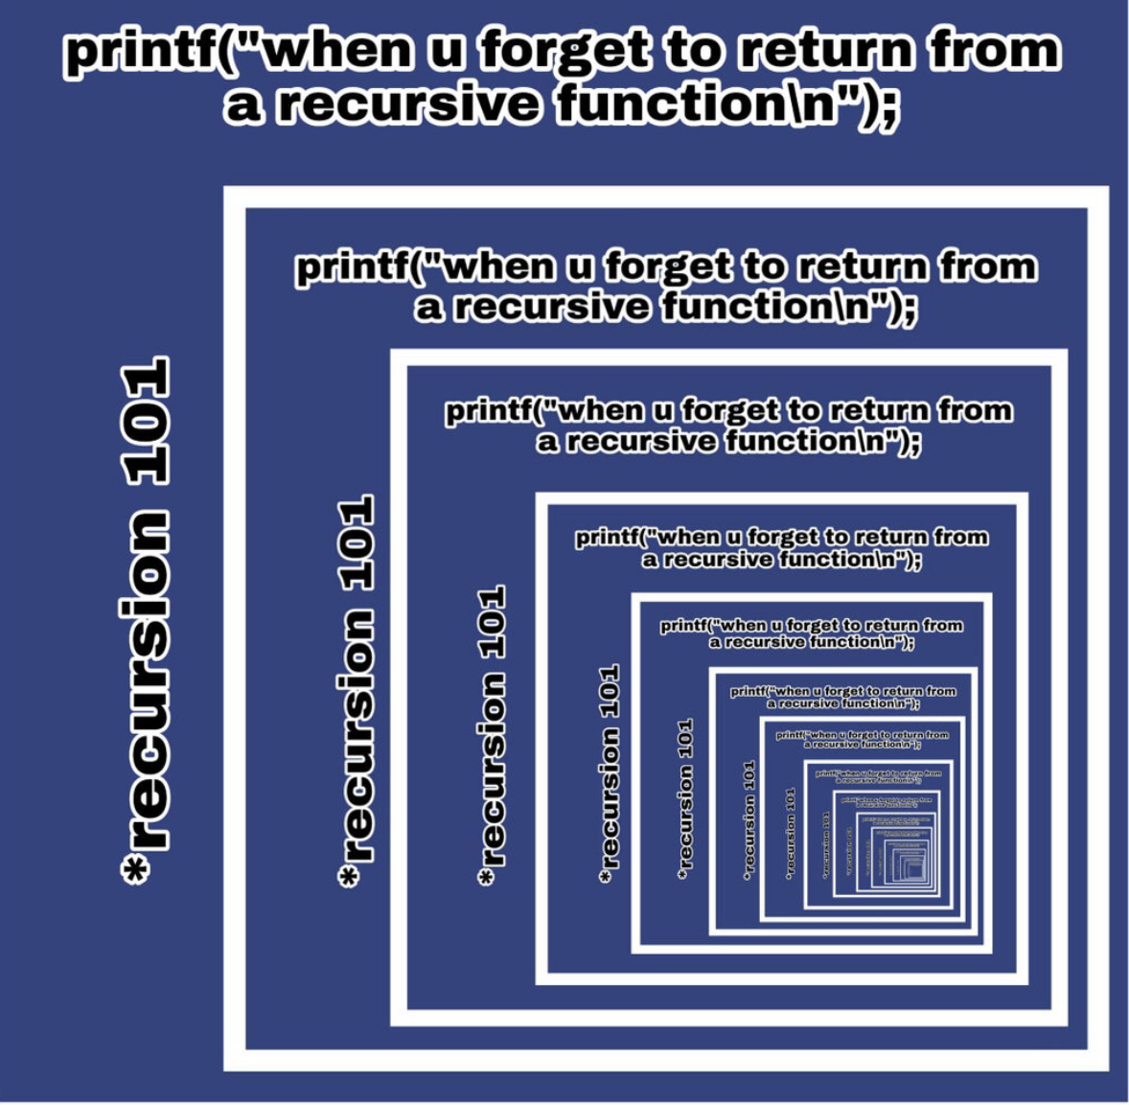
No Base Case?
Each recursive function call is not complete until it has reached a base case OR its recursive call is complete.
If you have no base case, the recursive function calls will keep calling over and over and over and over...

Slide 41
Write a recursive function that calculates the factorial of a given number.
A factorial of a number N is the product of all whole numbers between N and 1.
E.g. factorial(5) = 5*4*3*2*1 = 120
factorial(n) = n * factorial(n – 1)
factorial(1) = 1
int factorial(int n)
{
if(n == 1)
return 1;
return n * factorial(n – 1);
}

Slide 42
Consider the following code for a recursive function. Give the output value for the different function calls to this function.
rec(5), rec(6), rec(2)
int rec(int n)
{
if(n < 0)
return 0;
return n + rec(n - 2);
}
rec(5) = 9
rec(6) = 12
rec(2) = 2

Slide 43
Write a recursive function that returns the ‘n’th number in the Fibonacci Sequence. A Fibonacci sequence starts from 0,1 and all following numbers are the sum of the previous two numbers in the sequence.
0, 1, 1, 2, 3, 5, 8, 13, 21, 34, 55, 89, 144, 233, …
int fib(int n)
{
switch (n)
{
case 0:
case 1:
return n;
default:
return fib(n-1) + fib(n-2);
}
}
fib(n) = fib(n-1) + fib(n-2)
fib(0) = 0 AND fib(1) = 1

Slide 44
Write a recursive function that returns the MIN of an array.
E.g. int arr[] = {25,100,1,45,50}; n = 5
If n = 1, min = arr[0] Recursively reduce the array by one
int min(int arr[], int n)
{
if(n == 1)
return arr[0];
else
{
int t = min(arr+1, n-1);
if(arr[0] < t)
return arr[0];
else
return t;
}
}

Slide 45
Write a recursive function that returns the MAX of an array.
E.g. int arr[] = {25,100,1,45,50}; n = 5
If n = 1, max = arr[0] Recursively reduce the array by one
int max(int arr[], int n)
{
if(n == 1)
return arr[0];
else
{
int t = max(arr+1, n-1);
if(arr[0] > t)
return arr[0];
else
return t;
}
}

Slide 46
Use the down arrow to step through the trace in Slide Show
// Function to calculate n factorial
int g(int n)
{
int res;
if(n<=1)
res = 1;
else
res = n * g(n-1);
return res;
}
g(5) from main function
120
g
24
g
6
g
2
g
1
g
n = 5
res
n = 4
res
n = 3
res
n = 2
res
n = 1
res
120
5*24=120
4*6=24
3*2=6
2*1=2
1

Slide 47
// Function to calculate ‘n’th value of Fibonacci sequence
// 0,1,1,2,3,5,8,13,21,34,55,89,144,233
Use the down arrow to step through the trace in Slide Show
int fib(int n)
{
switch (n)
{
case 0:
case 1:
return n;
default:
return fib(n-1) + fib(n-2);
}
}
fib(4) from main function
3
1=3
fib
2+
n = 4
1=2
fib
1+
n = 3
0=1
fib
1+
n = 2
0=1
fib
1+
1
fib
n = 2
n = 1
1
fib
0
fib
n = 1
n = 0
1
fib
0
fib
n = 1
n = 0

Slide 48
// Function to calculate the MIN of a given array
// int arr[] = {25,100,1,45,50};
Use the down arrow to step through the trace in Slide Show
int g(int arr[], int n)
{
if(n==1)
return arr[0];
else
{
int t = g(arr+1,n-1);
if(arr[0] < t)
return arr[0];
else
return t;
}
}
g(arr, 5) from main function
1
g
1
g
1
g
45
g
50
g
n = 5
t =
n = 4
t =
n = 3
t =
n = 2
t =
n = 1
t =
1
45
50
1
1
-
ARRAY
{25,100,1,45,50}
{100,1,45,50}
{1,45,50}
{45,50}
{50}

Slide 49
// Function to calculate the MAX of a given array
// int arr[] = {25,100,1,45,50};
Use the down arrow to step through the trace in Slide Show
int g(int arr[], int n)
{
if(n==1)
return arr[0];
else
{
int t = g(arr+1,n-1);
if(arr[0] > t)
return arr[0];
else
return t;
}
}
g(arr, 5) from main function
100
g
100
g
50
g
50
g
50
g
n = 5
t =
n = 4
t =
n = 3
t =
n = 2
t =
n = 1
t =
100
50
50
100
50
-
ARRAY
{25,100,1,45,50}
{100,1,45,50}
{1,45,50}
{45,50}
{50}

